Slide 1

Usage Funnels with Warby Parker
Analyze Data with SQL
Alfred Champion
11/03/2021

Slide 2
Example Table of Contents
Title
Quiz Funnel
Question 1.
Question 2.
Question 3.
Home Try-on Funnel

Slide 3
1. Quiz Funnel

Slide 4
1.1. What Columns does the table have?
question | user_id | response
1. What are you looking for? | 005e7f99-d48c-4fce-b605-10506c85aaf7 | Women's Styles
2. What's your fit? | 005e7f99-d48c-4fce-b605-10506c85aaf7 | Medium
3. Which shapes do you like? | 00a556ed-f13e-4c67-8704-27e3573684cd | Round
4. Which colors do you like? | 00a556ed-f13e-4c67-8704-27e3573684cd | Two-Tone
1. What are you looking for? | 00a556ed-f13e-4c67-8704-27e3573684cd | I'm not sure. Let's skip it.
2. What's your fit? | 00a556ed-f13e-4c67-8704-27e3573684cd | Narrow
5. When was your last eye exam? | 00a556ed-f13e-4c67-8704-27e3573684cd | <1 Year
3. Which shapes do you like? | 00bf9d63-0999-43a3-9e5b-9c372e6890d2 | Square
5. When was your last eye exam? | 00bf9d63-0999-43a3-9e5b-9c372e6890d2 | <1 Year
2. What's your fit? | 00bf9d63-0999-43a3-9e5b-9c372e6890d2 | Medium
--Question 1.
SELECT *
FROM survey
LIMIT 10;

Slide 5
1.2. What is the number of responses per question?
-- Question 2.
SELECT question,
COUNT(DISTINCT user_id) AS '# of responses'
FROM survey
GROUP BY 1;
question | # of responses
1. What are you looking for? | 500
2. What's your fit? | 475
3. Which shapes do you like? | 380
4. Which colors do you like? | 361
5. When was your last eye exam? | 270

Slide 6
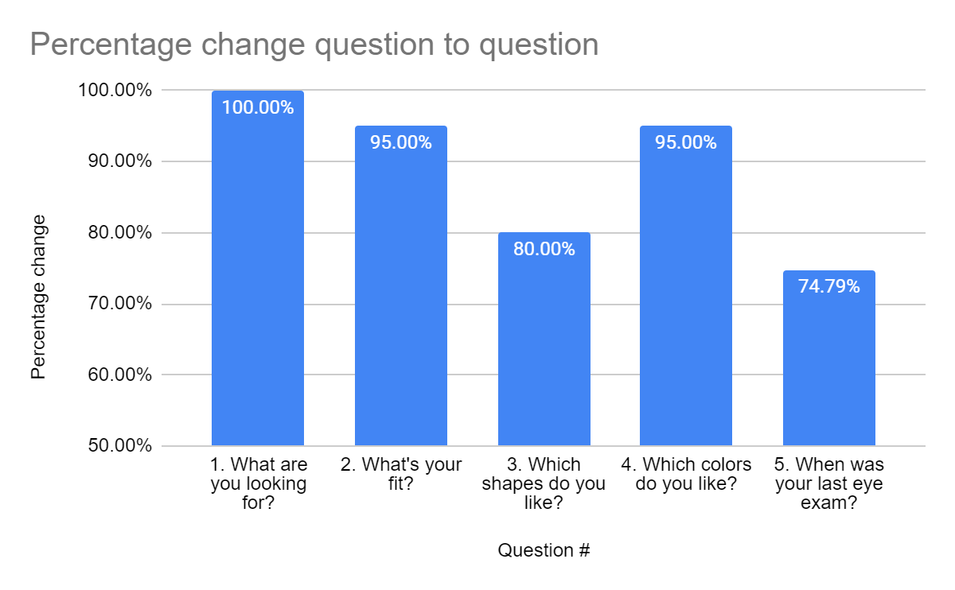
1.3. Which question(s) of the quiz
The largest drops in conversion are between questions 2 and 3, and questions 4 and 5 which both had 20% drops in response rate.
The drop from question 2 to question 3 could be explained by any of the following:
Respondents not liking any of the options presented to them
Not being able to decide a preference
If the respondents didn’t like any of the options presented to them this would explain why the conversion rate rises back up for question 3 to question 4 as only people who liked the options presented to them continued.
The drop from question 4 to question 5 is most likely caused by people not wanting to reveal some personal information about themselves.

Slide 7
2. Home Try-On Funnel

Slide 8
2.4. What are the column names?
user_id | style | fit | shape | color
4e8118dc-bb3d-49bf-85fc-cca8d83232ac | Women's Styles | Medium | Rectangular | Tortoise
291f1cca-e507-48be-b063-002b14906468 | Women's Styles | Narrow | Round | Black
-- Question 4.
SELECT *
FROM quiz
LIMIT 5;
SELECT *
FROM home_try_on
LIMIT 5;
SELECT *
FROM purchase
LIMIT 5;
-- Last 3 rows of each table removed so the columns could all fit on the slide
user_id | number_of_pairs | address
d8addd87-3217-4429-9a01-d56d68111da7 | 5 pairs | 145 New York 9a
f52b07c8-abe4-4f4a-9d39-ba9fc9a184cc | 5 pairs | 383 Madison Ave
user_id | product_id | style | model_name | color | price
00a9dd17-36c8-430c-9d76-df49d4197dcf | 8 | Women's Styles | Lucy | Jet Black | 150
00e15fe0-c86f-4818-9c63-3422211baa97 | 7 | Women's Styles | Lucy | Elderflower Crystal | 150

Slide 9
2.5. Usage Funnel Query and Results
user_id | is_home_try_on | number_of_pairs | is_purchase
4e8118dc-bb3d-49bf-85fc-cca8d83232ac | True | 3 pairs | False
291f1cca-e507-48be-b063-002b14906468 | True | 3 pairs | True
75122300-0736-4087-b6d8-c0c5373a1a04 | False |  | False
75bc6ebd-40cd-4e1d-a301-27ddd93b12e2 | True | 5 pairs | False
ce965c4d-7a2b-4db6-9847-601747fa7812 | True | 3 pairs | True
28867d12-27a6-4e6a-a5fb-8bb5440117ae | True | 5 pairs | True
5a7a7e13-fbcf-46e4-9093-79799649d6c5 | False |  | False
0143cb8b-bb81-4916-9750-ce956c9f9bd9 | False |  | False
a4ccc1b3-cbb6-449c-b7a5-03af42c97433 | True | 5 pairs | False
b1dded76-cd60-4222-82cb-f6d464104298 | True | 3 pairs | False
-- Question 5
SELECT q.user_id,
CASE WHEN
h.user_id IS NOT NULL THEN 'True'
ELSE 'False'
END AS 'is_home_try_on',
h.number_of_pairs,
CASE WHEN
p.user_id IS NOT NULL THEN 'True'
ELSE 'False'
END AS 'is_purchase'
FROM quiz q
LEFT JOIN home_try_on h
ON h.user_id = q.user_id
LEFT JOIN purchase p
ON p.user_id = q.user_id
LIMIT 10;

Slide 10
2.5. Usage Funnel Query and Results
number_of_pairs | # of users | num_home_try_on | num_purchase | home to buy [%]
3 pairs | 379 | 379 | 201 | 53.03
5 pairs | 371 | 371 | 294 | 79.25
-- Question 6
WITH funnels AS (
SELECT q.user_id,
h.user_id IS NOT NULL AS 'is_home_try_on',
h.number_of_pairs,
p.user_id IS NOT NULL AS 'is_purchase'
FROM quiz q
LEFT JOIN home_try_on h
ON h.user_id = q.user_id
LEFT JOIN purchase p
ON p.user_id = q.user_id)
SELECT number_of_pairs,
COUNT(*) AS '# of users',
SUM(is_home_try_on) AS 'num_home_try_on',
SUM(is_purchase) AS 'num_purchase',
ROUND(100.0 * SUM(is_purchase)/SUM(is_home_try_on),2) AS 'home to buy [%]'
FROM funnels
WHERE number_of_pairs IS NOT NULL
GROUP BY 1;

